Slide 1
Chapter 1: Introduction to Accounting and Business
Financial & Managerial Accounting, 16e

Slide 2
Role of Accounting in Business
Accounting can be defined as an information system that provides reports to users about the economic activities and condition of a business.

Slide 3
Financial accounting and Managerial accounting
We have 2 types of Accounting
Financial accounting and Managerial accounting
Notes:
The area of accounting that provides internal users with information is called managerial accounting, or management accounting. The objective of managerial accounting is to provide relevant and timely information for managers’ and employees’ decision-making needs. Managerial accountants employed by a business are employed in private accounting.
The area of accounting that provides external users with information is called financial accounting. The objective of financial accounting is to provide relevant and timely information for the decision-making needs of users outside of the business. General-purpose financial statements are one type of financial accounting report that is distributed to external users. The term general-purpose refers to the wide range of decision-making needs that these reports are designed to serve.

Slide 4
Financial accounting
Financial accounting: provides information about a company’s performance to external users, such as investors, creditors, customers, and the government by preparing Financial Statements.
Notes:
The area of accounting that provides internal users with information is called managerial accounting, or management accounting. The objective of managerial accounting is to provide relevant and timely information for managers’ and employees’ decision-making needs. Managerial accountants employed by a business are employed in private accounting.
The area of accounting that provides external users with information is called financial accounting. The objective of financial accounting is to provide relevant and timely information for the decision-making needs of users outside of the business. General-purpose financial statements are one type of financial accounting report that is distributed to external users. The term general-purpose refers to the wide range of decision-making needs that these reports are designed to serve.

Slide 5
Managerial Accounting
Managerial accounting is to provide relevant and timely information for managers’ and employees’ decision-making needs
Notes:
The area of accounting that provides internal users with information is called managerial accounting, or management accounting. The objective of managerial accounting is to provide relevant and timely information for managers’ and employees’ decision-making needs. Managerial accountants employed by a business are employed in private accounting.
The area of accounting that provides external users with information is called financial accounting. The objective of financial accounting is to provide relevant and timely information for the decision-making needs of users outside of the business. General-purpose financial statements are one type of financial accounting report that is distributed to external users. The term general-purpose refers to the wide range of decision-making needs that these reports are designed to serve.

Slide 6
The Accounting Equation
The following equation shows the relationship among assets, liabilities, and equity:
Assets = Liabilities + Equity
This equation is called the accounting equation.
Notes:
The resources owned by a business are its assets.
The rights of creditors are the debts of the business and are called liabilities.
The rights of owners are called equity.
Since stockholders own a corporation, equity is called stockholders’ equity.
For a proprietorship, partnership, or limited liability company, equity is called owner’s equity.

Slide 7
The Accounting Equation
The resources owned by a business are its assets.
The rights of creditors are the debts of the business and are called liabilities.
The rights of owners are called equity.
Since stockholders own a corporation, equity is called stockholders’ equity.
For a proprietorship, partnership, or limited liability company, equity is called owner’s equity.
Notes:
The resources owned by a business are its assets.
The rights of creditors are the debts of the business and are called liabilities.
The rights of owners are called equity.
Since stockholders own a corporation, equity is called stockholders’ equity.
For a proprietorship, partnership, or limited liability company, equity is called owner’s equity.

Slide 8
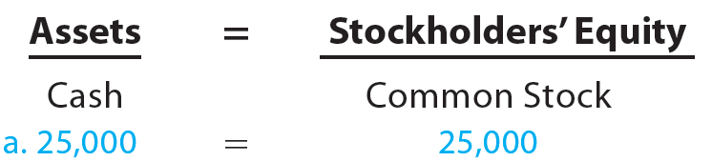
Transaction a
Nov. 1, 20Y3: Chris Clark deposited $25,000 in a bank account in the name of NetSolutions in exchange for shares of common stock in the corporation.
A corporation issues common stock to investors as proof of their ownership rights.

Slide 9
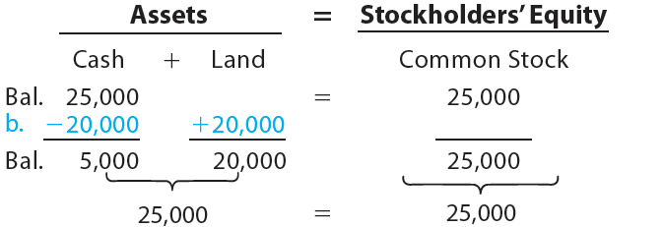
Transaction b
Nov. 5, 20Y3: NetSolutions paid $20,000 for the purchase of land as a future building site.

Slide 10
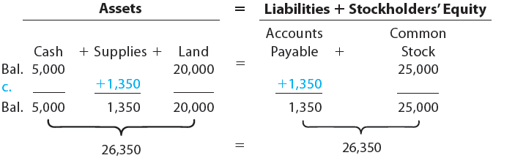
Transaction c
Nov. 10, 20Y3: NetSolutions purchased supplies for $1,350 and agreed to pay the supplier in the near future.

Slide 11
Transaction d
Revenue is the amount earned for selling goods or services to customers.
The revenue recognition principle determines when revenue is recorded in the accounting records.
Normally, revenue is recorded when the services have been performed or goods are delivered to the customer.

Slide 12
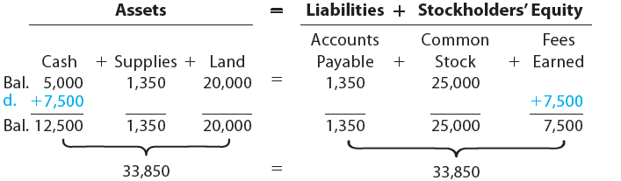
Transaction d
Nov. 18, 20Y3: NetSolutions received cash of $7,500 for providing services to customers.

Slide 13
Principles
Expenses are amounts used to generate revenue.
The expense recognition principle, sometimes called the matching principle, requires expenses to be recorded in the same period as the related revenue.
Doing so allows the reporting of a profit or loss for the period.

Slide 14
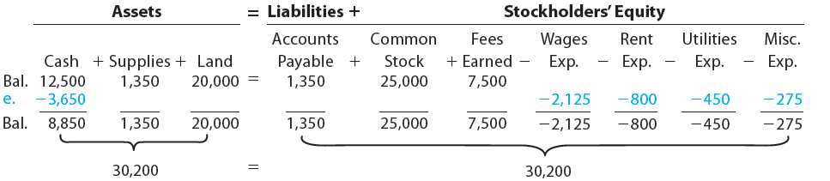
Transaction e
Nov. 30, 20Y3: NetSolutions paid the following expenses during the month: wages, $2,125; rent, $800; utilities, $450; and miscellaneous, $275.

Slide 15
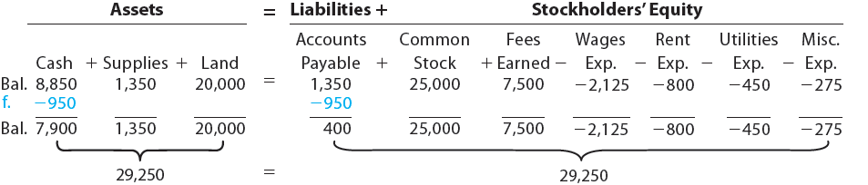
Transaction f
Nov. 30, 20Y3: NetSolutions paid creditors on account, $950.

Slide 16
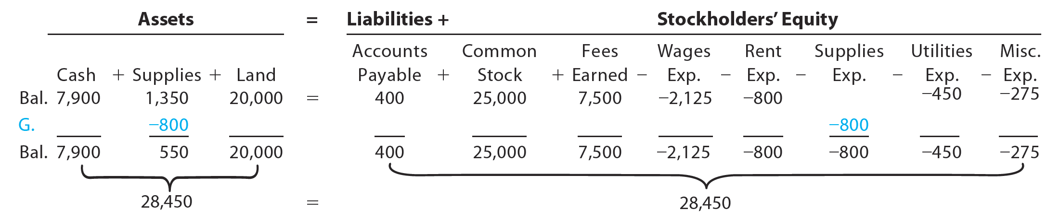
Transaction g
Nov. 30, 20Y3: Chris Clark determined that the cost of supplies on hand at the end of the month was $550.
The cost of the supplies on hand (not yet used) at the end of the month is $550.
Thus, $800 ($1,350 − $550) of supplies must have been used during the month. This decrease in supplies is recorded as an expense, as follows:

Slide 17
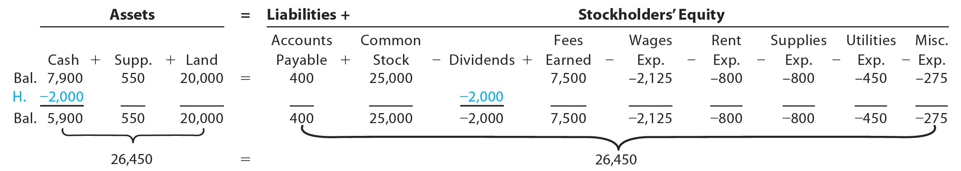
Transaction h
Nov. 30, 20Y3: Paid dividends, $2,000.
Dividends are distributions of earnings to stockholders.

Slide 18
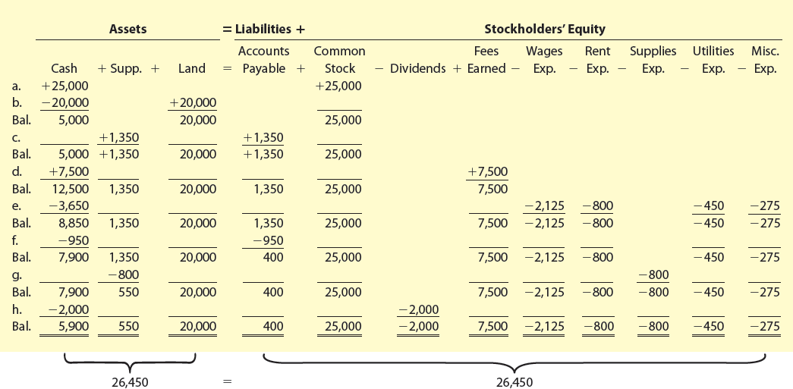
Exhibit 6 – Summary of Transactions for NetSolutions
Notes:
The effect of every transaction is an increase or a decrease in one or more of the accounting equation elements.
The two sides of the accounting equation are always equal.
The stockholders’ equity is increased by amounts invested by stockholders (common stock).
The stockholders’ equity is increased by revenues and decreased by expenses.
The stockholders’ equity is decreased by dividends paid to stockholders.

Slide 19
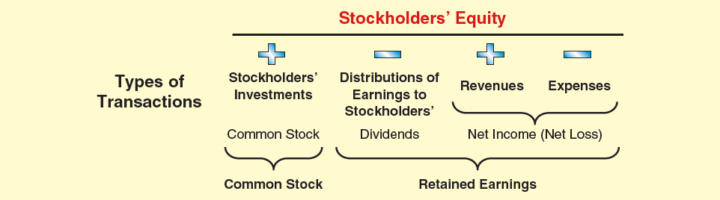
Exhibit 7 – Effects of Transactions on Stockholders’ Equity
Retained earnings is the stockholders’ equity created from business operations through revenue and expense transactions.
Notes:
Stockholders’ equity is classified as:
Common Stock
Retained Earnings
Stockholders’ equity created by investments by stockholders (common stock) and by business operations (retained earnings) are reported separately.

Slide 20
Knowledge Check Activity 2
Hampshire Havens buys an adjoining piece of land to expand their golf course. They pay $89,000 in cash to acquire this land. Based on the accounting equation, what would be the effect of this transaction?
Cash +89,000, Land +89,000
Cash -89,000, Land +89,000
Cash +89,000, Land -89,000
Cash -89,000, Land -89,000

Slide 21
Knowledge Check Activity 2: Answer
Hampshire Havens buys an adjoining piece of land to expand their golf course. They pay $89,000 in cash to acquire this land. Based on the accounting equation, what would be the effect of this transaction?
Answer: b. Cash -89,000, Land +89,000
Cash would decrease by $89,000, and Land would increase by $89,000

Slide 22
Financial Statements (Learning Objective 5)
After transactions have been recorded and summarized, reports are prepared for users.
The accounting reports providing this information are called financial statements.
The primary financial statements of a corporation are the income statement, statement of stockholders’ equity, balance sheet, and statement of cash flows.

Slide 23
Exhibit 8 – Financial Statements
Order Prepared | Financial Statement | Description of Statement
1. | Income statement | A summary of the revenue and expenses for a specific period of time, such as a month or a year.
2. | Statement of stockholders’ equity | A summary of the changes in stockholders’ equity that have occurred during a specific period of time, such as a month or a year.
3. | Balance sheet | A list of the assets, liabilities, and stockholders’ equity as of a specific date, usually at the close of the last day of a month or a year.
4. | Statement of cash flows | A summary of the cash receipts and cash payments for a specific period of time, such as a month or a year.

Slide 24
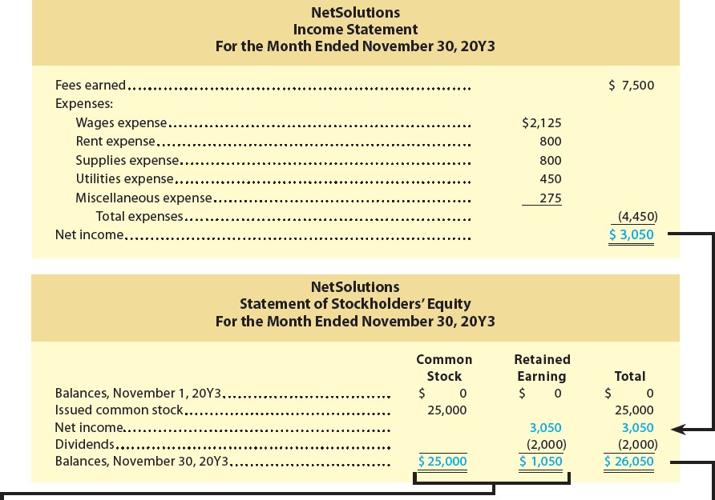
Exhibit 9 – Financial Statements for NetSolutions (1 of 2)

Slide 25
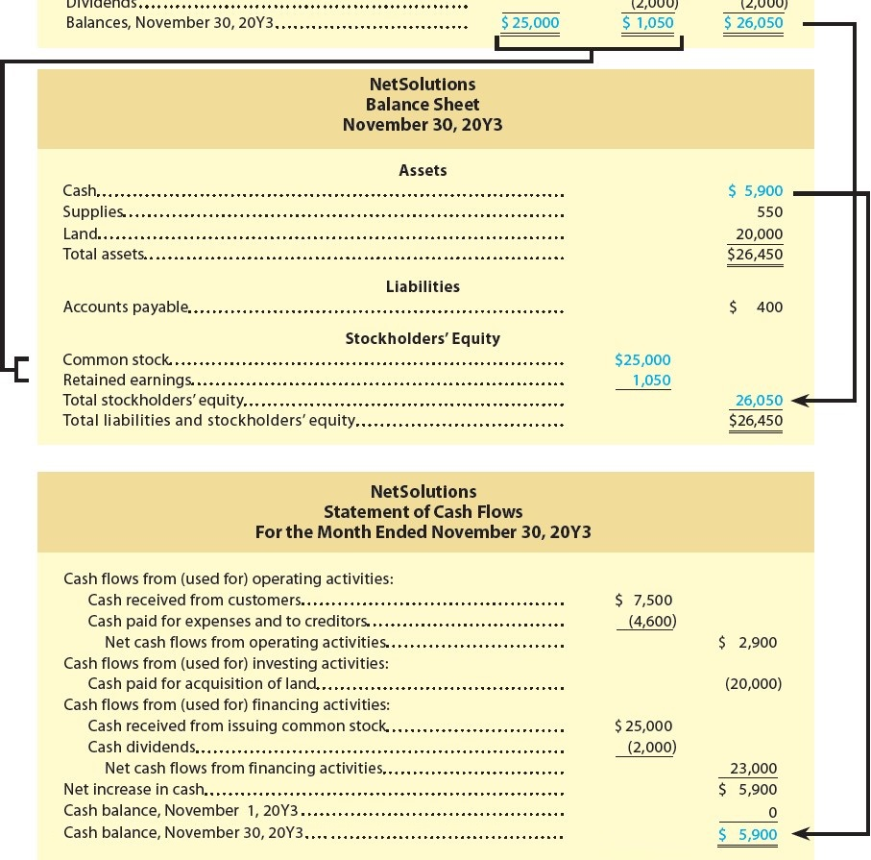
Exhibit 9 – Financial Statements for NetSolutions (2 of 2)

Slide 26
Knowledge Check Activity 3
Which financial statement would a stockholder want to review if they are interested in the company’s sales and expenses?
Balance Sheet
Statement of Cash Flows
Income Statement
Statement of Shareholders’ Equity

Slide 27
Knowledge Check Activity 3: Answer
Which financial statement would a stockholder want to review if they are interested in the company’s sales and net income?
Answer: c. Income Statement
The income statement would list a company’s sales, expenses, and net loss.

